Slide 1
Online Job Portal
Job portal is an application which connects employer and job seekers where employers are the source of the resources and the job seeker can find and apply for their targeted job.

Slide 2
Need for new System
1. Proposed Job Portal system consists of 3 modules: Job Seeker, Employer and Administrator.
2. Online Job Portal will provide the fast operation and low cost expense than old system.
3. Easy job search, which is a job seeker need

Slide 3
SOFTWARE REQUIREMENT
Operating System : Window XP, Windows 7 (mini.)
Front –End : HTML, Java Script, PHP
Back-End : PHP, MYSQL
Supporting Server : Apache Tomcat 5.5 WampServer, Xampp

Slide 4
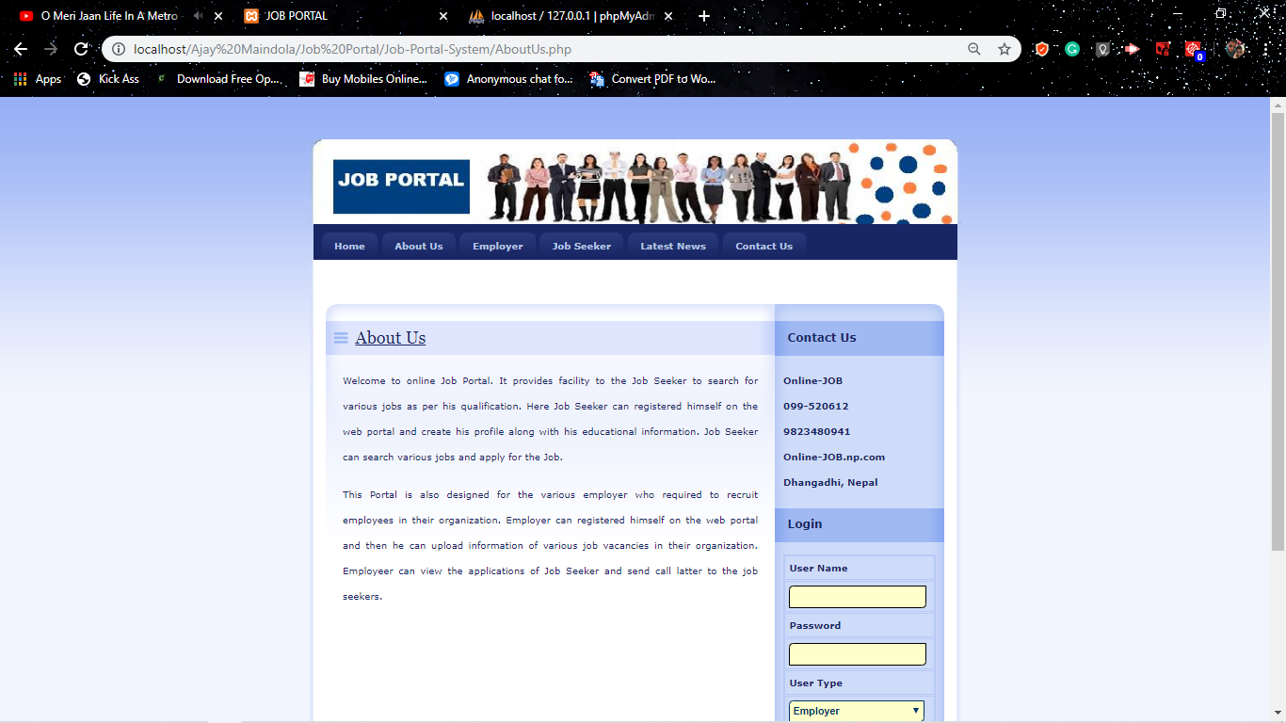
Screen Shots:
Job Portal Home Page

Slide 5
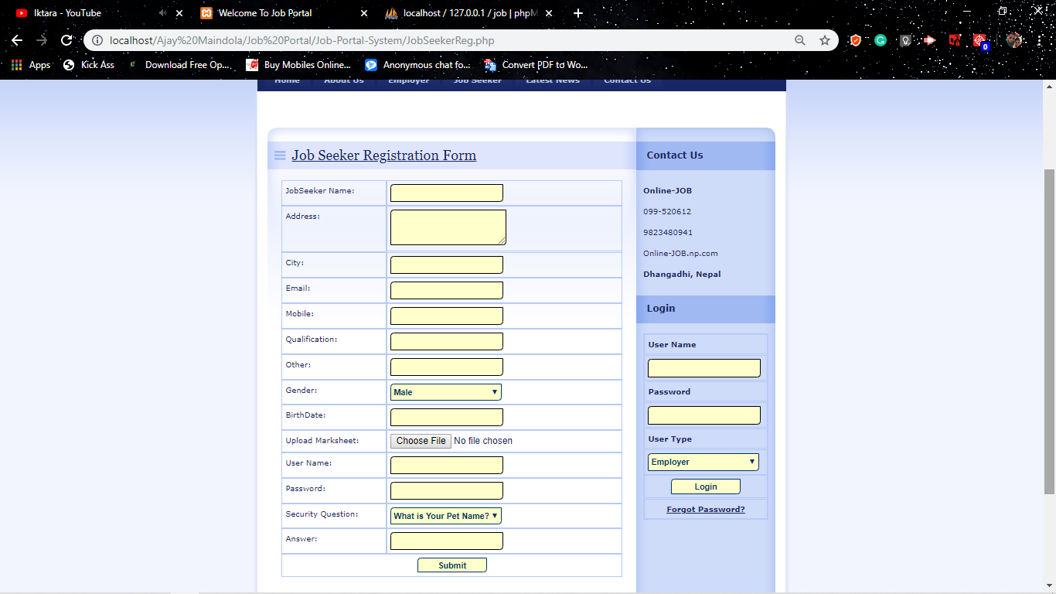
Employee Registration Page

Slide 6
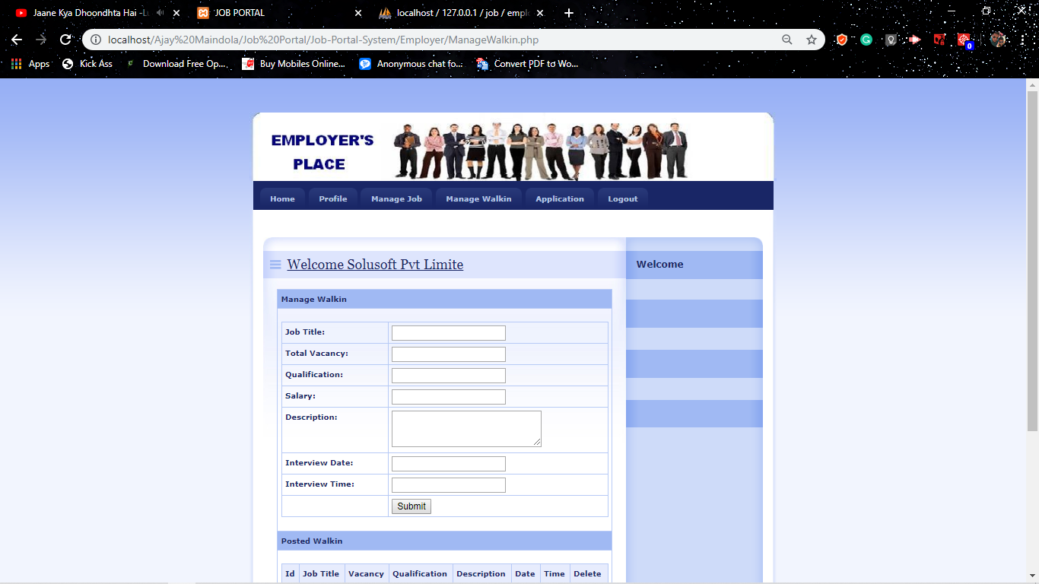
Manage Job Page

Slide 7
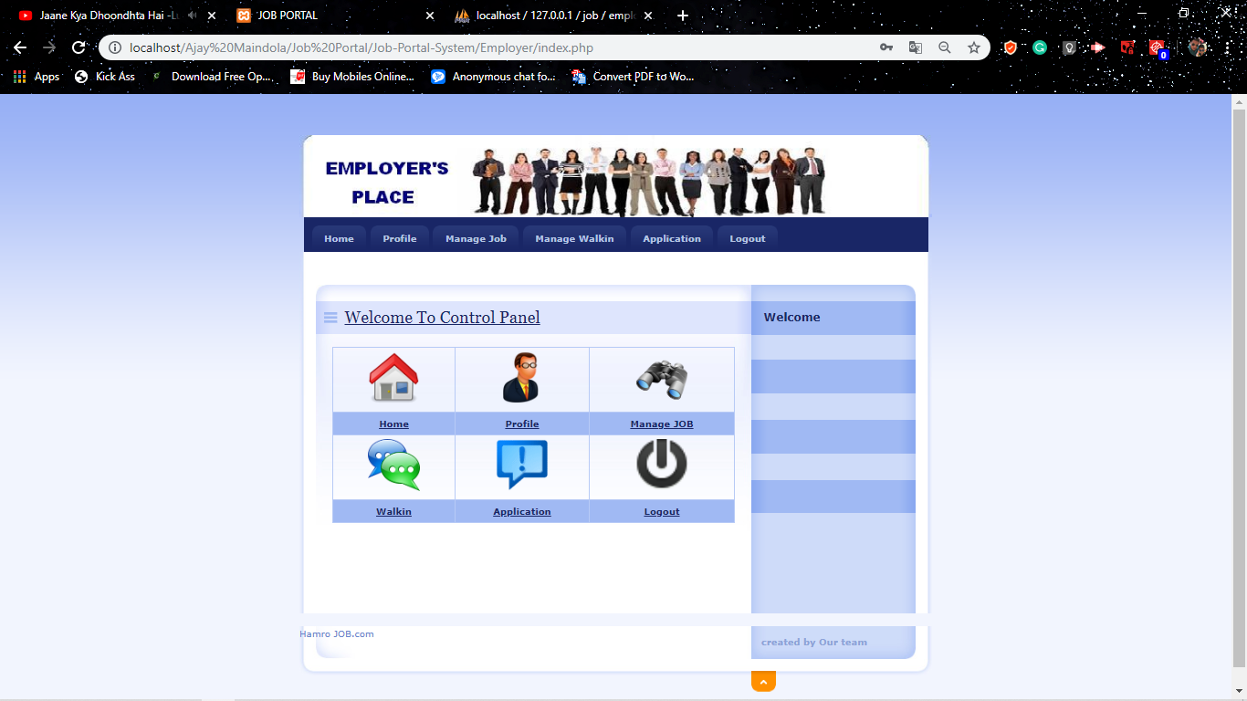
Admin Page: Employer

Slide 8
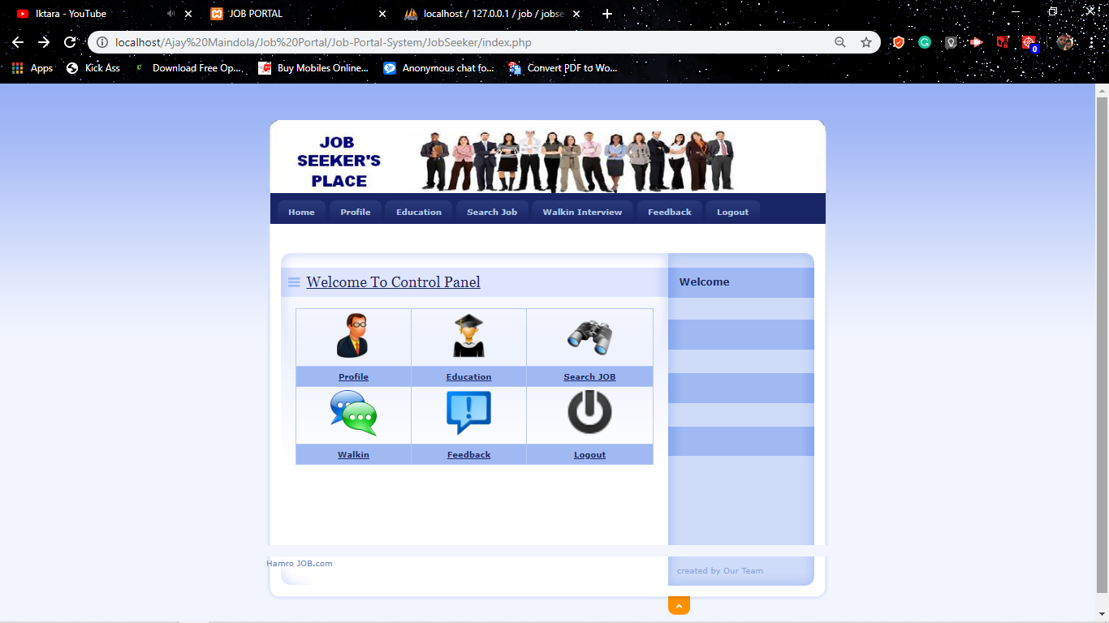
Admin Page: Job Seeker

Slide 9
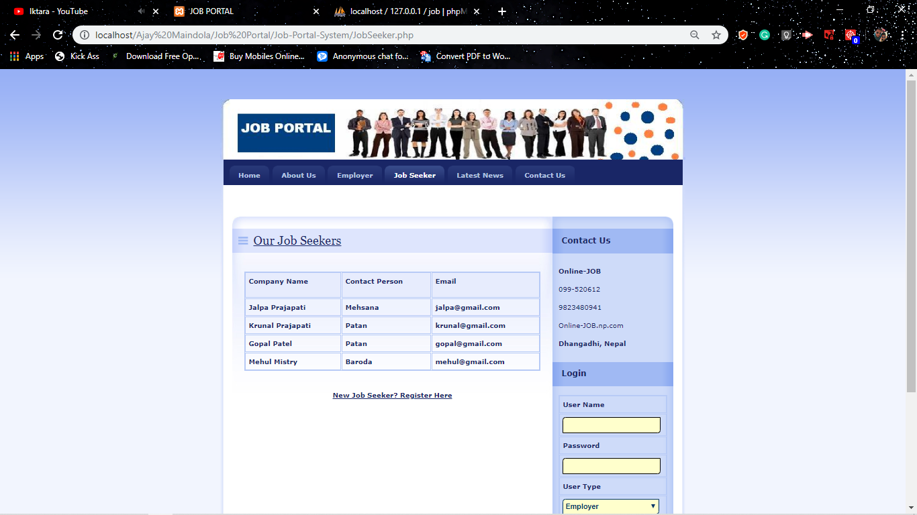
Contact With Company

Slide 10
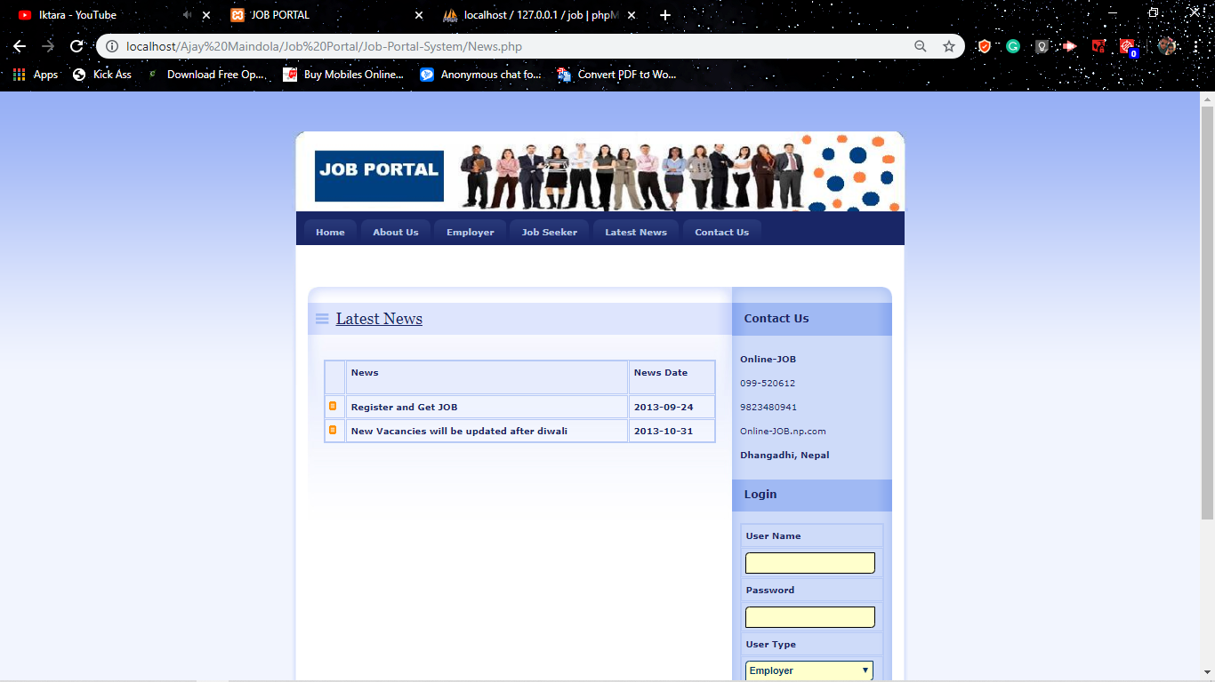
Updates & Notifications

Slide 11
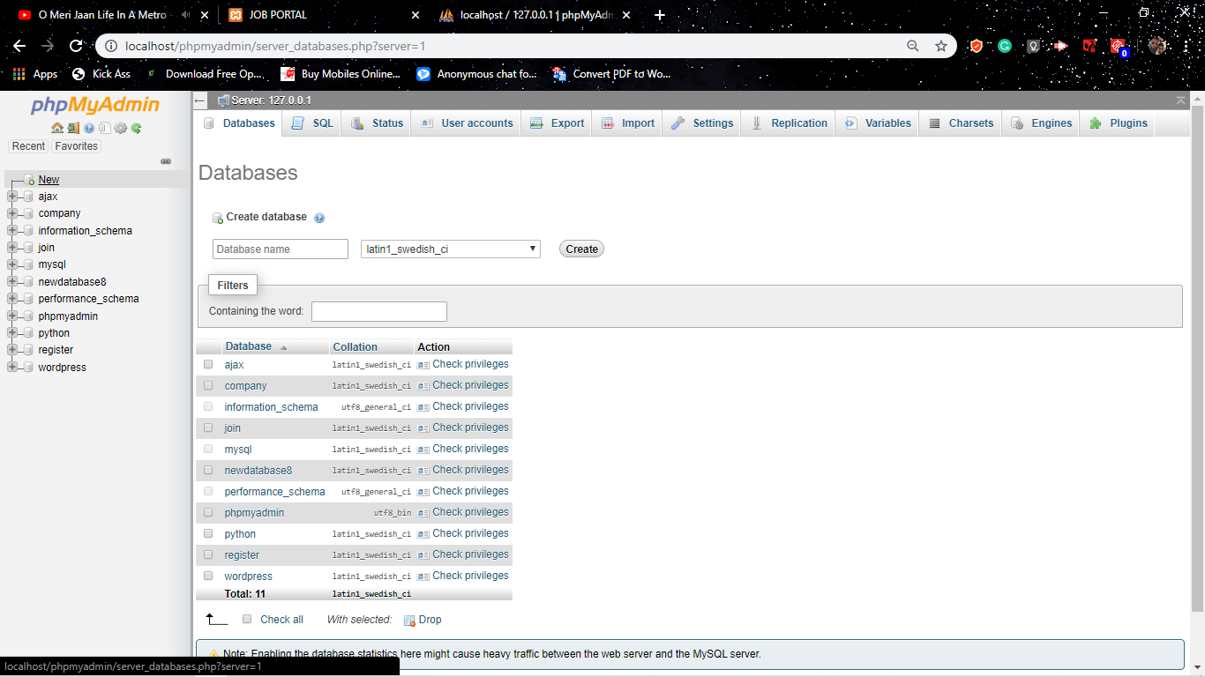
Database SQL

